Slide 1

Agriculture, Food, and Natural Resources Education
Master of Arts
Program
Milestones
https://www.canr.msu.edu/csus/graduate/programs/afnre/

Slide 2

Objectives
Upon completion of video, students will be able to:
  Determine an appropriate timeline for the AFNRE MA program;
  Define a student’s program chair and program of study (courses);
  Determine appropriate tasks to complete in the Campus Solutions system (Annual Review, RECR training).
  Define an appropriate impact project (CSUS898)
https://www.canr.msu.edu/csus/graduate/programs/afnre/

Slide 3
Timeline for your MA Program
Consider creating a timeline that matches your…
  Financial Commitment;
  Time Commitment; and
  Remember 5-years from first class.
  Refer to timeline document on AFNRE program site.
https://www.canr.msu.edu/csus/graduate/programs/afnre/

Slide 4
Program Chair and Course of Study
Upon entry into your MA program, you have been assigned a program chair.
Selecting an appropriate additional member
Determining a course of study.
Program Plan in SIS
Once you have determined additional member and determined appropriate courses, you will need to go into the Campus Solutions system and fill in the appropriate fields for both components highlighted above.
https://www.canr.msu.edu/csus/graduate/programs/afnre/

Slide 5
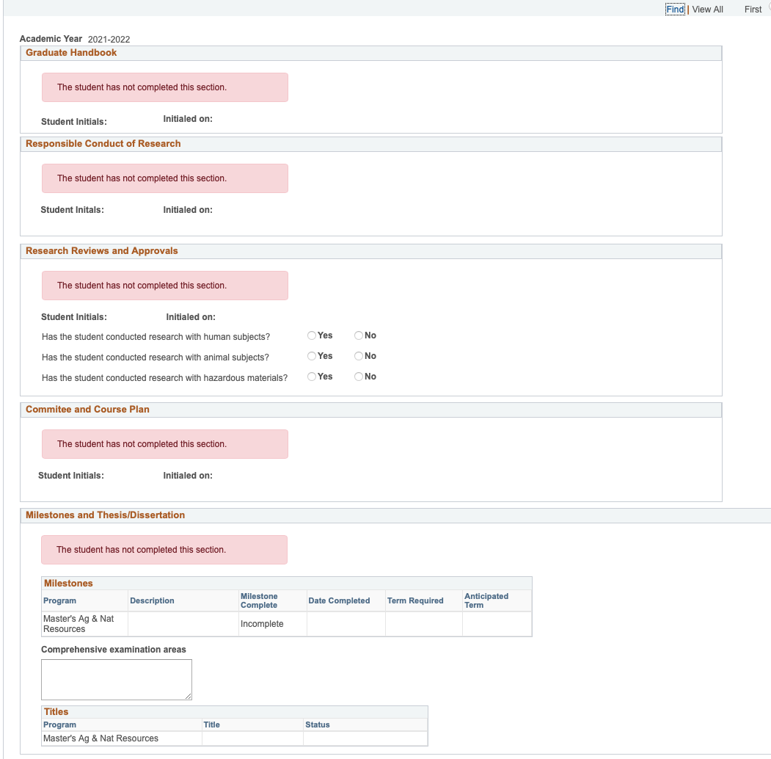
Campus Solutions Milestones

Slide 6
Campus Solutions
As highlighted above, Campus Solutions will be the location where you keep track of much of your program.
Annual Review
RECR Training
https://www.canr.msu.edu/csus/graduate/programs/afnre/

Slide 7
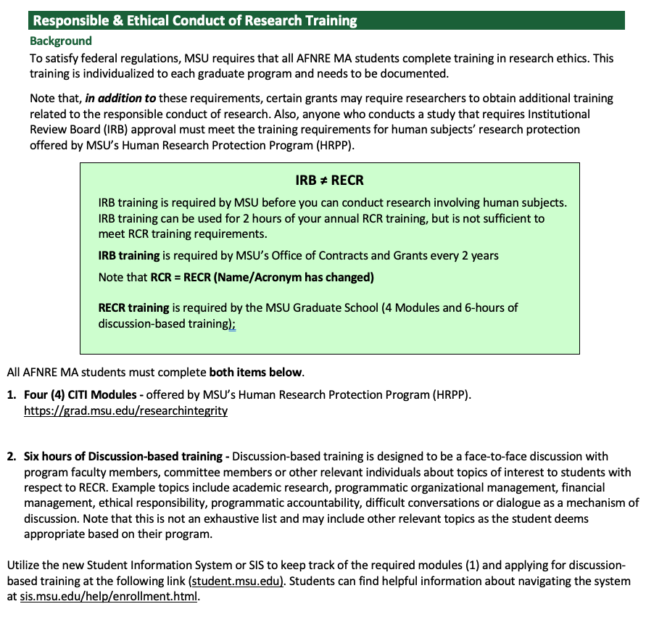
RECR Training

Slide 8
Defining an Appropriate Impact Project
As part of your program, you are required to develop an impact project (CSUS898).
This is developed and completed in conjunction with your committee.
Impact Project’s must be approved as part of the completion process.
Impact Project guidelines are available as a resource.
Previous Impact Projects
https://www.canr.msu.edu/csus/graduate/programs/afnre/

Slide 9
Questions?
Contact
Michael Everett, GPD AFNRE MA
everettm@msu.edu or 517-581-5888
https://www.canr.msu.edu/csus/graduate/programs/afnre/

